Slide 1


Trip With the Flow – AI Powered Travel Buddy
Nate Seon Ayush Kumar Gupta, En-Xiang Lin
Team 7
MSCS
School of Technology & Computing (STC)

Slide 2
Agenda
Problem Statement
Motivation
Background
Key Features
System Component Comparison
User Personas & Journey Mapping
Future Work
Conclusion
User Interface
Demo
References

Slide 3

Problem Statement
Travel planning is overwhelming:
Too many options
Manual itinerary building
Unfamiliar locations
Our Goal: Make travel planning effortless and enjoyable with AI-powered assistance.

Slide 4
Motivation
People seek personalized, flexible travel experiences
AI can revolutionize itinerary planning

Slide 5
Background
Rise of generative AI in consumer services
Google's Gemini API: interactional, multimodal
Shift from manual to AI-infused and optimized planning

Slide 6
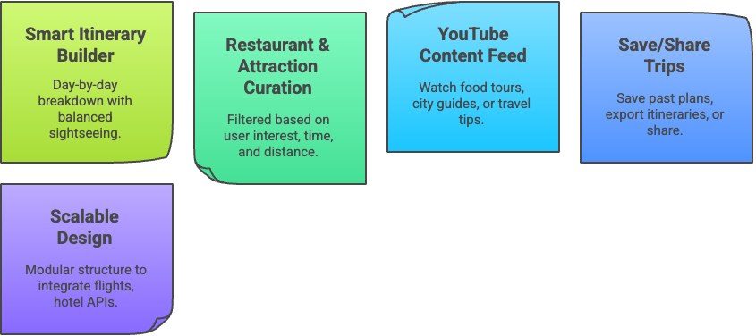
Key Features

Slide 7
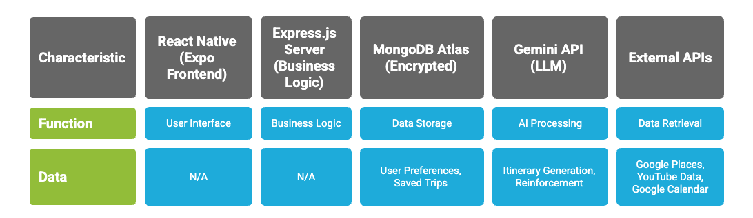
System Component Comparison

Slide 8
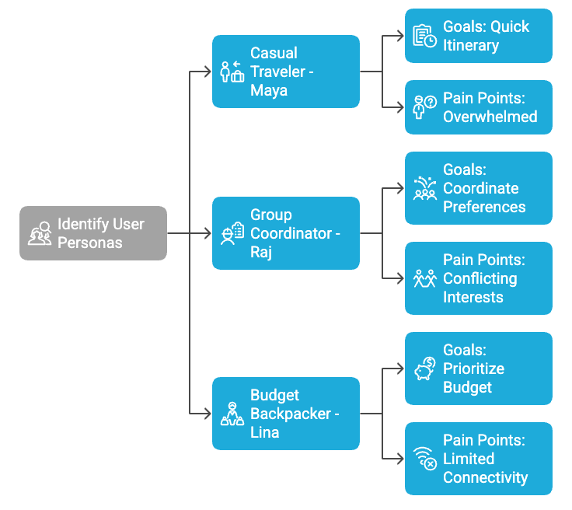
User Personas & Journey Mapping

Slide 9
Future Work
Budget based planning
Ai BOT interaction
Make reservation for you

Slide 10
Conclusion
"Trip With the Flow":
User-Friendly Mobile Interface
Seamless Trip Planning Experience
Efficient data storage and retrieval

Slide 11
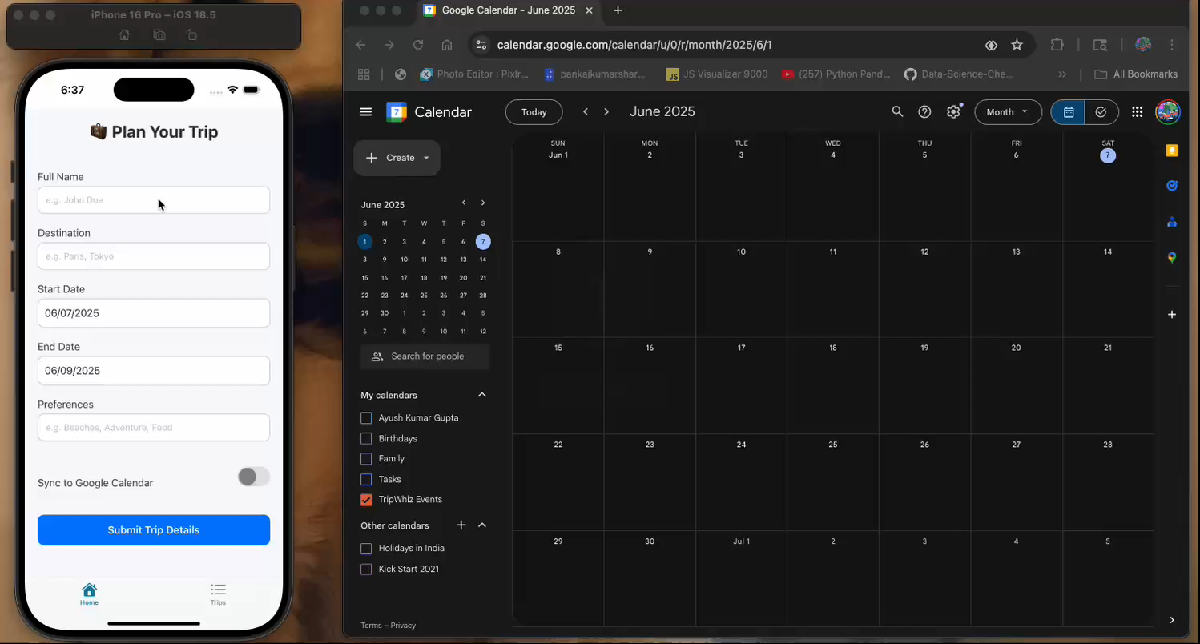
Demo

Slide 12
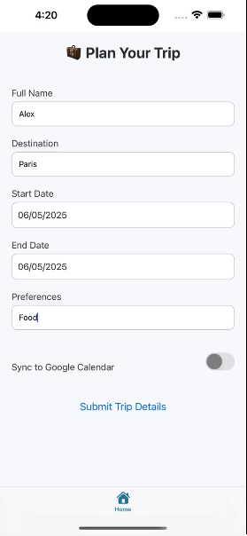
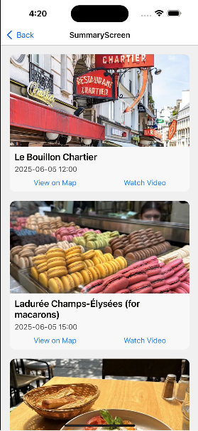
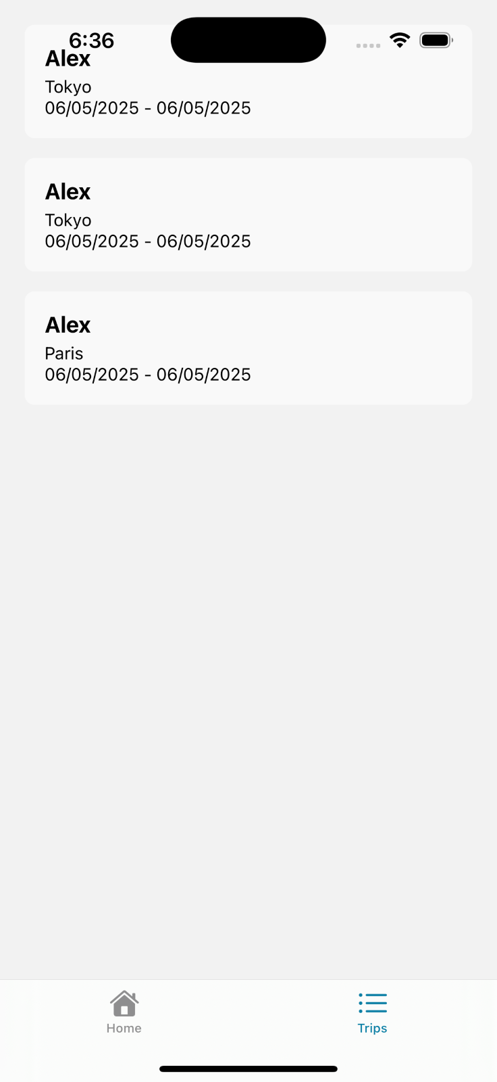
User Interface

Slide 13
References
Google AI. (2024). Gemini API Documentation. https://ai.google.dev
Google Developers. (n.d.). Google Places API Overview. https://developers.google.com/maps/documentation/places/web-service/overview
Google Developers. (n.d.). YouTube Data API Overview. https://developers.google.com/youtube/v3
Manideep, K. V., Atuliya, R., Viswan, V., Ganesh, D. A., Reddy, S. B., Shetty, S., & Dept. of Computer Science and Engineering, (Aiml), Jain (Deemed To Be) University. (2024). Trip Planner using Generative AI. In International Journal for Multidisciplinary Research (IJFMR) (Vol. 6, Issue 3, pp. 1–2).

Slide 14
References
MongoDB. (n.d.). MongoDB Developer Documentation. https://www.mongodb.com/docs/
Express.js. (n.d.). Express - Node.js web application framework. https://expressjs.com/
React Native. (n.d.). React Native Documentation. https://reactnative.dev/docs/getting-started
Expo. (n.d.). Expo Documentation. https://docs.expo.dev/
Travel Itinerary Planner using AI. (2024). [Journal-article]. International Research Journal of Engineering and Technology (IRJET), 11(04), 888. https://www.irjet.net/archives/V11/i4/IRJET-V11I4152.pdf

Slide 15


Q&A

